Slide 1
Motivation
Why does the Distributed Unified (Fast) architecture provide only a modest improvement over the Direct architecture in logical error?
If the Direct architecture performs almost as well, what justifies the additional complexity of distributed quantum computing ?
Objective of This Week
To investigate the fundamental architectural trade-offs between direct and distributed quantum computing by analyzing:
Communication overhead versus routing overhead
Circuit depth and spacetime-volume reduction
The impact of fast photonic interconnects
Long-term scalability and modularity
Is distributed quantum computing advantageous because it reduces logical error, or because it remains scalable when direct architectures reach their physical limits?

Slide 2
Why Are Direct and Distributed-Fast So Close ?
Communication Cost vs. Routing Cost
Logical Error Model
PL≈Nlocalpl+N2Qp2Q+NcommPcomm+Tλ
Where:
Nlocalpl : Local gate errors
N2Qp2Q : Two-qubit gate errors
NcommPcomm: Communication-induced errors
Tλ: Decoherence accumulated during execution
Distributed-Fast Architecture
Additional Cost
Ncomm>0
Bell-pair generation
Teleportation
Classical communication
Compensating Benefits
Fewer SWAP gates
Reduced routing complexity
Smaller circuit depth
Less qubit idle time
Faster execution
Direct Architecture
Advantages
Ncomm=0
No Bell-pair generation
No teleportation
No classical synchronization
Limitations
Long SWAP chains
Larger routing overhead
Increased idle time
Higher circuit depth
The communication overhead introduced by distributed execution is largely compensated by reductions in routing overhead, circuit depth, and decoherence. As a result, the logical error of the optimized Distributed-Fast architecture becomes only slightly lower than that of the Direct architecture.

Slide 3
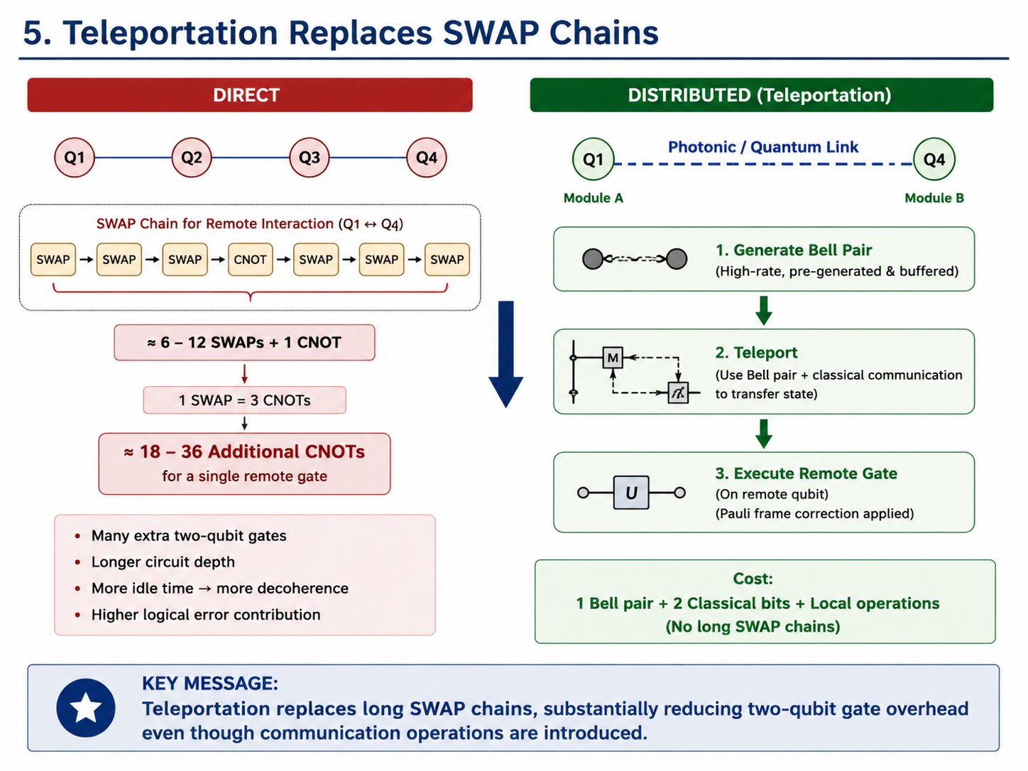
Teleportation Replaces SWAP Chains
Teleportation replaces long SWAP chains, substantially reducing two-qubit gate overhead even though communication operations are introduced.

Slide 4
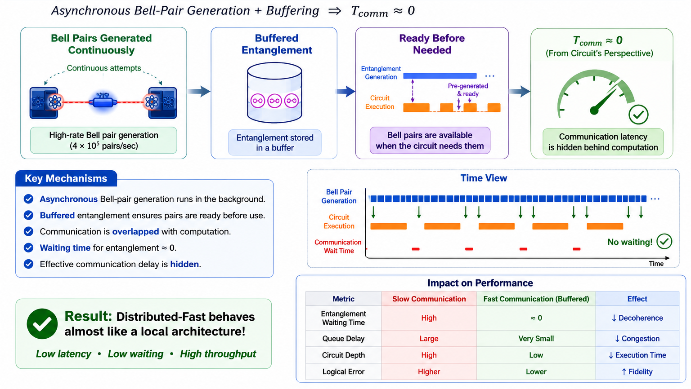
Fast Communication Hides Latency
Fast Buffered and asynchronous communication is the key that makes distributed competitive or even better with direct architecture.

Slide 5
Why Does Distributed-Fast Still Win?
Direct Architecture
Advantages
No inter-module communication
No Bell-pair generation
No classical synchronization
Disadvantages
Long SWAP chains
Higher routing overhead
Larger circuit depth
Increased qubit idle time
Distributed-Fast Architecture
Additional Cost
Bell-pair generation
Teleportation
Classical communication
Compensating Advantages
Eliminates long SWAP chains
Reduces routing overhead
Shortens execution depth
Reduces idle-time decoherence
High-rate pre-generated Bell pairs hide communication latency
The communication cost introduced by distributed execution is largely compensated by the reduction in circuit depth, routing overhead, and qubit idle time. Consequently, the total space-time error volume remains comparable to that of the direct architecture, explaining why the two logical-error curves are very close while the distributed-fast architecture still maintains a consistent advantage
Notes:
At first glance, one would expect distributed quantum computing to have much higher logical error because it introduces Bell-pair generation, teleportation, and classical synchronization. However, these communication costs are compensated by a significant reduction in routing overhead and circuit depth. Instead of executing long SWAP chains, remote operations are performed through teleportation using high-fidelity pre-generated Bell pairs. This reduces qubit idle time and overall decoherence. Therefore, although distributed-fast performs additional communication operations, its total space-time error remains comparable to that of the direct architecture, resulting in only a small but consistent improvement in logical error.

Slide 6
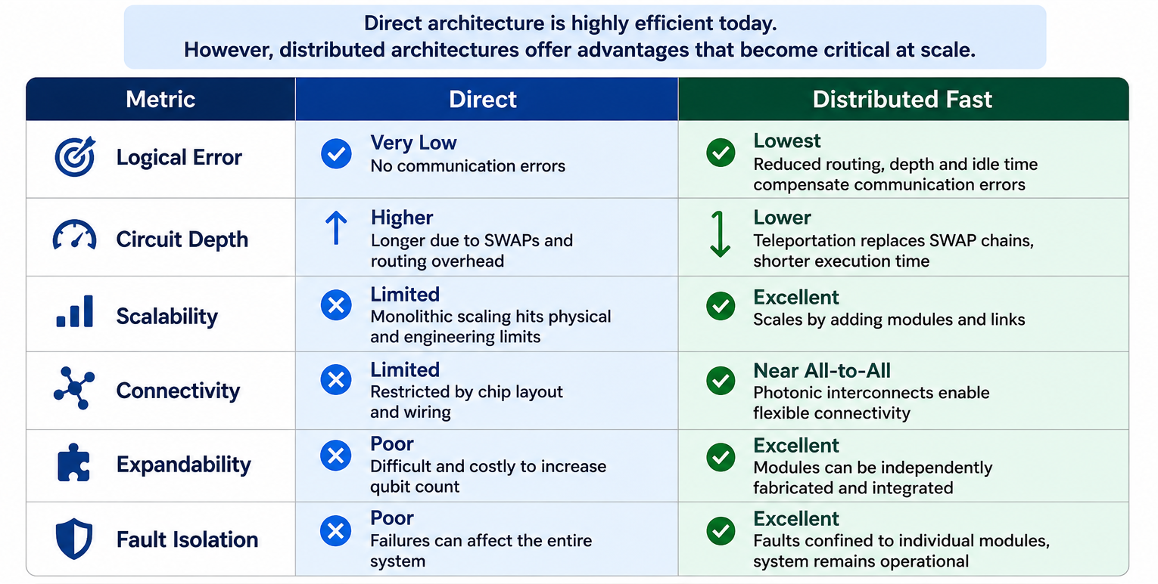
If Direct Performs So Well… Why Not Use Direct?
Direct is excellent for small – medium systems but the distributed fast is the architecture for the future large scale robust quantum computing.

Slide 7
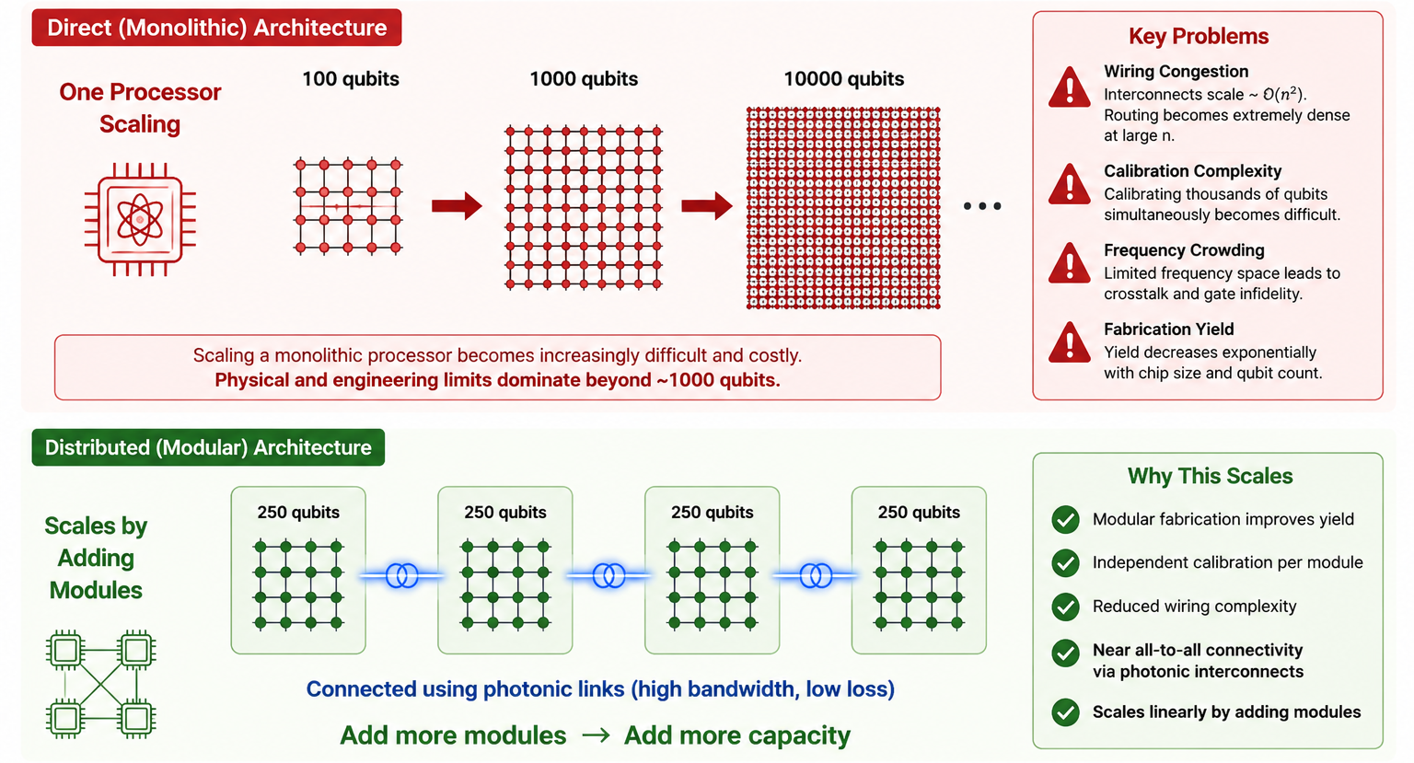
Physical Scalability Limits
Distributed systems overcome physical limits and enable scalable quantum computing.

Slide 8
Why Distributed Is the Future
While the Direct architecture achieves competitive logical error for small- to medium-scale systems, its scalability is fundamentally constrained by the physical limitations of a single quantum processor.
Direct Architecture | Distributed-Fast Architecture
Single large quantum processor | Multiple modular quantum processors
Wiring and control complexity increase rapidly | Complexity distributed across modules
Calibration becomes increasingly difficult | Individual modules calibrated independently
Hardware failure affects the entire processor | Faults isolated to individual modules
Limited physical expansion | Modular expansion by adding new QPUs
Performance improvements rely mainly on local hardware | Can exploit future advances in photonic networking and quantum communication
Why Distributed Architectures Are Preferred
Modular fabrication simplifies manufacturing and improves device yield.
Independent calibration allows each QPU to be optimized separately.
Fault isolation confines hardware failures to individual modules, improving reliability.
Incremental scalability enables additional QPUs to be integrated without redesigning the existing processor.
Future compatibility with high-fidelity photonic interconnects, multiplexing, and quantum repeaters provides a clear roadmap for continued performance improvements.
Distributed quantum computing addresses these limitations through modular design and high-speed quantum interconnects, providing a practical pathway toward large-scale fault-tolerant quantum computing.​
Direct architectures provide excellent performance at today's scales, whereas distributed architectures are designed to sustain comparable performance as quantum systems expand to thousands or millions of qubits

Slide 9
Future Improvements Benefit Only Distributed Systems
Technology | Expected Impact
High-rate Bell-pair generation | Reduces entanglement generation latency and communication waiting time
Photonic Integrated Circuits (PICs) | Enable compact, low-loss, high-bandwidth optical interconnects
Quantum Repeaters | Extend reliable long-distance entanglement distribution
Frequency/Time Multiplexing (FDM/TDM) | Increase communication parallelism and improve channel utilization
Intelligent Routing & Scheduling | Minimize congestion, queueing delays, and routing overhead
Why Direct Architectures Do Not Benefit Similarly
Direct (monolithic) architectures are fundamentally limited by on-chip physical constraints, including:
Wiring congestion
Control electronics complexity
Frequency crowding
Crosstalk
Fabrication yield limitations
Calibration overhead
These limitations are intrinsic to the processor and cannot be significantly alleviated by advances in quantum networking technologies.
Advances in quantum networking continuously improve distributed architectures by reducing communication overhead, whereas direct architectures remain constrained by the physical limits of a single quantum processor. Consequently, distributed quantum computing provides a more sustainable pathway toward large-scale, fault-tolerant quantum systems.

Slide 10
Key Findings
Communication Overhead Can Be Hidden
Optimized photonic interconnects, pre-generated Bell pairs, and asynchronous communication effectively hide most communication latency, allowing distributed execution to approach the performance of local quantum operations.
Teleportation Is More Efficient Than Long SWAP Chains
Although teleportation introduces communication operations, it replaces long sequences of SWAP gates required in monolithic or direct architectures. The resulting reduction in two-qubit operations and idle time compensates for communication overhead, leading to comparable or lower logical error rates.
Scalability Is a System-Level Property
Architecture selection cannot be based solely on logical error. Long-term scalability depends on modularity, communication efficiency, fault isolation, expandability, and maintainability. Distributed architectures provide a practical pathway toward fault-tolerant quantum systems containing thousands to millions of qubits.
Logical Error Is Governed by Space–Time Volume
Logical performance is determined by the combined effect of circuit depth, qubit idle time, routing overhead, and communication fidelity. Consequently, reducing execution depth can offset the additional errors introduced by inter-module communication.
Distributed-Fast Achieves Communication-Scalable Performance
The Distributed-Fast architecture combines high-fidelity photonic communication, intelligent routing, multiplexing, and scheduling to achieve logical error rates comparable to direct execution while significantly improving scalability and communication efficiency.
The results demonstrate that optimized distributed quantum computing does not outperform direct architectures by eliminating communication overhead, but by balancing communication, routing, and execution depth. As communication technologies mature, modular distributed architectures provide the most practical route toward scalable fault-tolerant quantum computing.

